Slide 1
Tutorial 9
Statistical Computation and Analysis
Spring 2026

Slide 2
Tutorial Outline
Model comparison
Important terms
AIC
WAIC
K-fold Cross Validation (CV)
Pareto-smoothed Importance Sampling Leave One Out Cross Validation (PSIS-LOO-CV)

Slide 3
Model Comparison
How can we compare two or more models for the same data?
We have used posterior predictive checks to assess how well a model explains the data used to fit a model.
We have looked at Bayesian p values for goodness of fit.
Now we’ll learn additional methods for comparing between models.

Slide 4
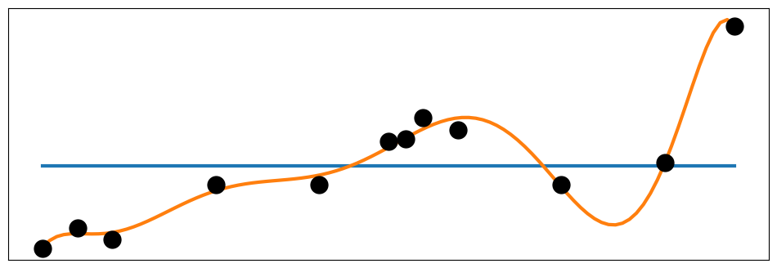
Overfitting and underfitting
Underfitting: The model is too simple & misses important structure.
Overfitting: The model is too flexible & follows noise in the data.
A useful model balances fit and generalization.

Slide 5
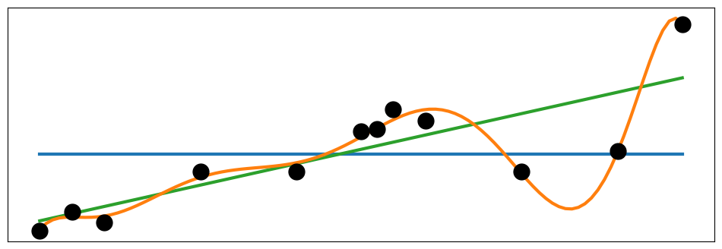
Model Comparison
We aim for:
High goodness of fit
Model fits the data
Lower complexity
Fewer parameters, more parameters can lead to overfitting
Occam's razor
High generalizability
Model predicts future data well

Slide 6
Accuracy
Within-sample accuracy :
The accuracy is measured with the same data used to fit the model.
Out-of-sample accuracy :
The accuracy measured with data not used to fit the model.
The within-sample accuracy will be higher and lead us to believe our model is better than it is.
Leaving data out means less data to fit our model.

Slide 7
Model Comparison
To overcome this, we will use two methods:
Information criteria: Expressions that approximate out-of-sample accuracy as in-sample accuracy plus a term that penalizes model complexity.
Cross-validation: A method that involves dividing the available data into separate subsets that are alternatively used to fit and evaluate the models.
Notes:
To get out‐of‐sample estimates without permanently carving out a test set, we can use:
Information criteria (e.g. WAIC, formerly DIC) which add a complexity penalty to an in-sample log-likelihood.
Cross-validation, where we repeatedly fit on part of the data and test on the rest.
Both quantify how well a model generalizes without giving away all our data up front.

Slide 8
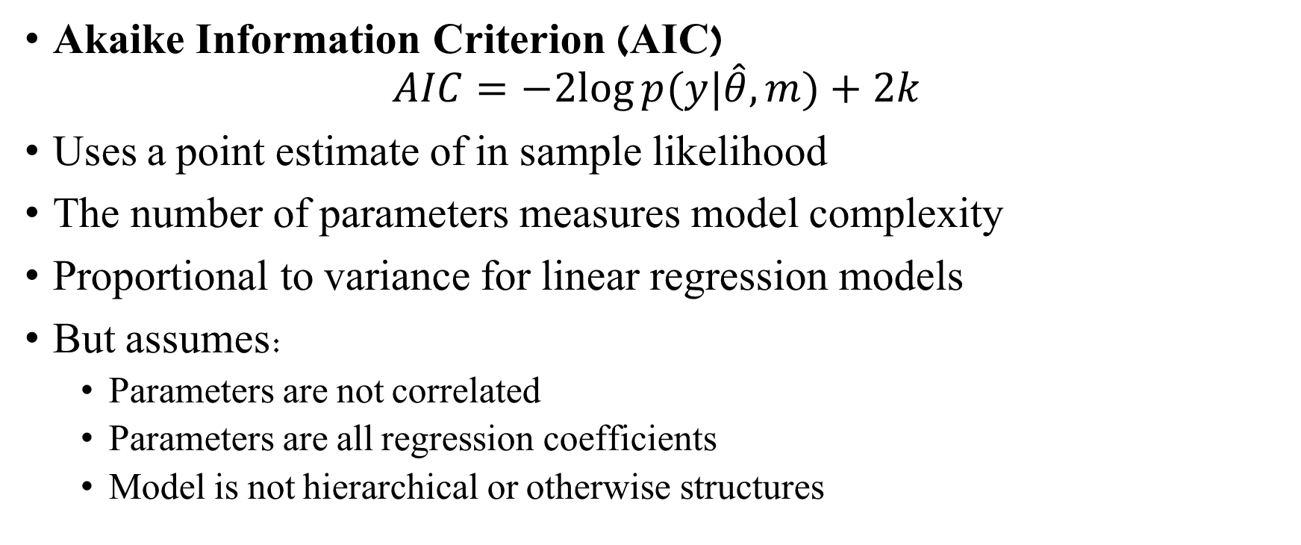
Frequentist Information Criterion
Akaike Information Criterion (AIC)
$$AIC=−2log⁡p(y|\hat{θ},m)+2k$$
Uses a point estimate of in sample likelihood
The number of parameters measures model complexity
Proportional to variance for linear regression models
But assumes:
Parameters are not correlated
Parameters are all regression coefficients
Model is not hierarchical or otherwise structures

Slide 9
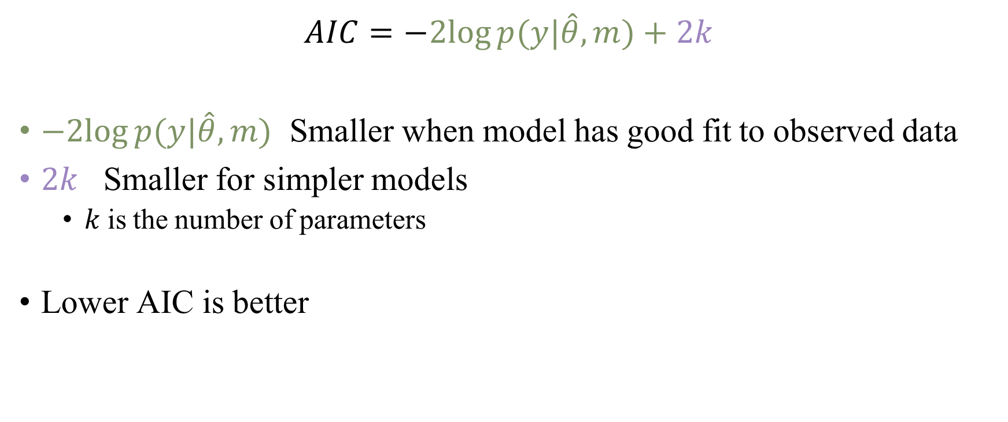
Frequentist Information Criterion
$$AIC=−2log⁡p(y|\hat{θ},m)+2k$$
$−2log⁡p(y|\hat{θ},m)$ Smaller when model has good fit to observed data
$2k$ Smaller for simpler models
$k$ is the number of parameters
Lower AIC is better

Slide 10
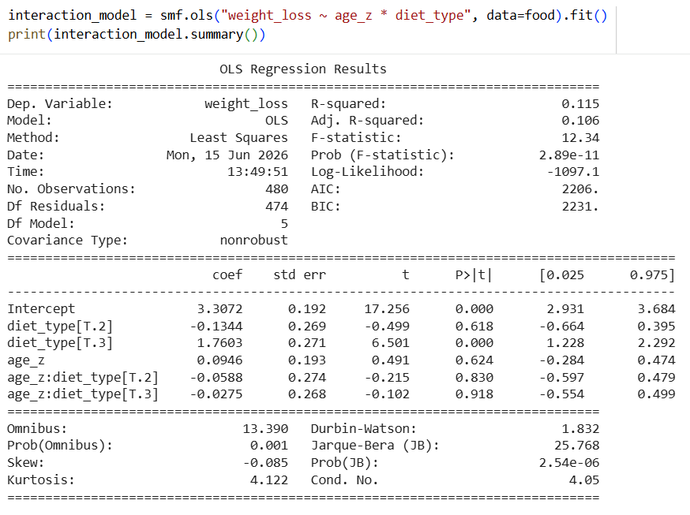
Frequentist Information Criterion
You can see AIC in the ols model summary and compare models.
For example from tutorial 8:
Notes:
From tutorial 8

Slide 11

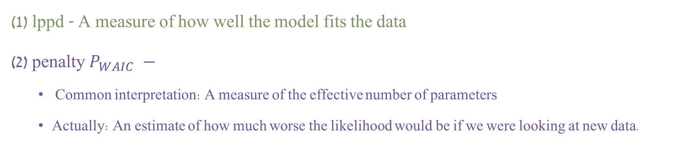

Widely Applicable Information Criteria
Log pointwise predictive density (lppd)
Penalty $P_{WAIC}$
(1) lppd - A measure of how well the model fits the data
(2) penalty $P_{WAIC} −$
Common interpretation: A measure of the effective number of parameters
Actually: An estimate of how much worse the likelihood would be if we were looking at new data.
Notes:
The second - An estimate of how much worse the likelihood would be if we were looking at new data.
Correcting for how much the likelihood would change if I had new data.
Log pointwise predictive density (lppd)
For each observation y_i​, we average its likelihood under each posterior draw, (הסוגריים שבתוך הלוג)
We then take the log, and sum over i=1…n.
Intuitively this estimates how well the model predicts new data “on average.”
Effective number of parameters, pWAIC
For each y_i​, compute the sample variance across draws of its log-likelihood.
Summing these variances gives a measure of model complexity: if the log-likelihood varies a lot between draws, the model is effectively more flexible (has more “parameters”).
Why the −2 and the +2?
The whole criterion is written on the deviance (“–2 log-likelihood”) scale so it’s directly comparable to DIC or AIC.
We pick the model with the smallest WAIC.

Slide 12
Widely Applicable Information Criteria
Log pointwise predictive density (lppd)
Penalty $P_{WAIC}$
We will choose the model with the lower WAIC.
If two models fit the data equally well, we will choose the simpler one.
Notes:
The second - An estimate of how much worse the likelihood would be if we were looking at new data.
Correcting for how much the likelihood would change if I had new data.

Slide 13
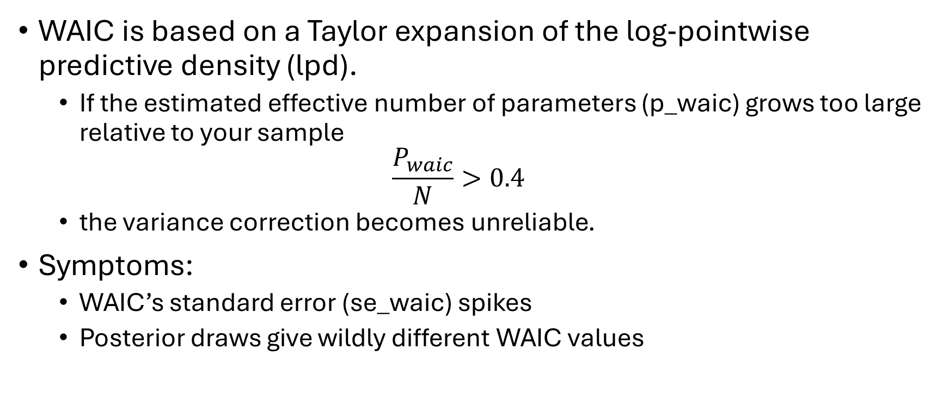
When can’t we trust WAIC?
WAIC is based on a Taylor expansion of the log‐pointwise predictive density (lpd).
If the estimated effective number of parameters (p_waic) grows too large relative to your sample
$$\frac{P_{waic}}{N}>0.4$$
the variance correction becomes unreliable.
Symptoms:
WAIC’s standard error (se_waic) spikes
Posterior draws give wildly different WAIC values
https://python.arviz.org/en/latest/api/generated/arviz.waic.html
Notes:
https://python.arviz.org/en/latest/api/generated/arviz.waic.html

Slide 14
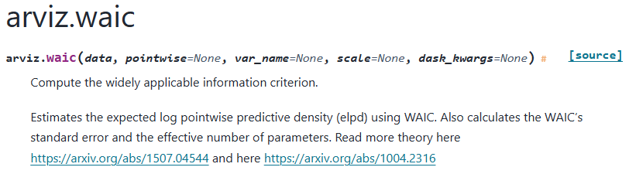
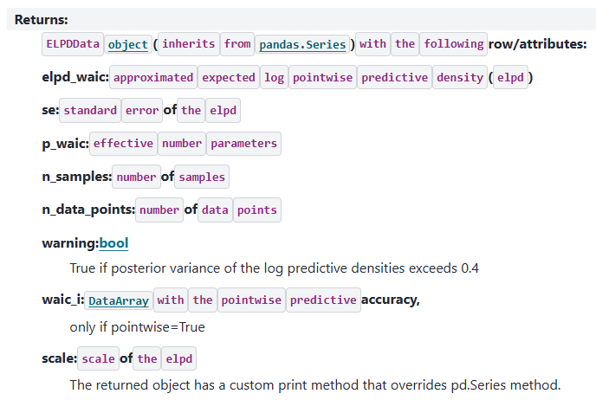
When can’t we trust WAIC?
https://python.arviz.org/en/latest/api/generated/arviz.waic.html
Notes:
https://python.arviz.org/en/latest/api/generated/arviz.waic.html

Slide 15
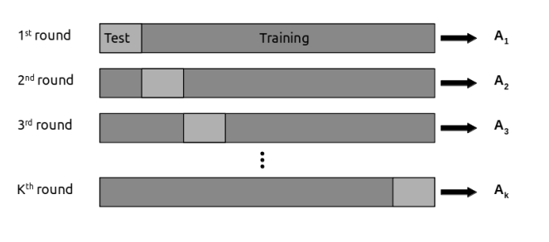
K-fold Cross Validation
Divide our data into k parts.
Use k-1 parts to fit the model and test it on the left-out portion.
We get k models and k accuracy values.
The accuracy of the model is the average of the k accuracy values.
Fit the model on all the data one final time.
This is the final model for future use.

Slide 16
LOO Cross Validation
When K equals the number of data points, we get what is known as leave-one-out cross validation (LOO-CV), meaning we fit the model to all but one data point each time.
Practically, this is computationally expensive, and we are going to estimate it by approximating the expected log likelihood of new data
Notes:
הפיתוח של הנוסחה במצגת הרצאה 10

Slide 17
PSIS-LOO-CV
LOO uses Pareto-smoothed importance sampling to approximate refits.
Importance sampling means we sample the proposal distribution instead of the target distribution & weigh the samples according to the ratio.
This is problematic if the importance weight is too high.
Notes:
דרך אינטואיטיבית: יש לי דגימות מהפוסטריור עם כל הנתונים, במקום להריץ את הדגימה מחדש בלי נבדק מסוים אני לוקחת את הדגימות ונותנת להם משקלים חדשים שמדמים איך הפוסטריור היה נראה אילו הנבדק לא היה קיים בסט נתונים המקורי.

Slide 18
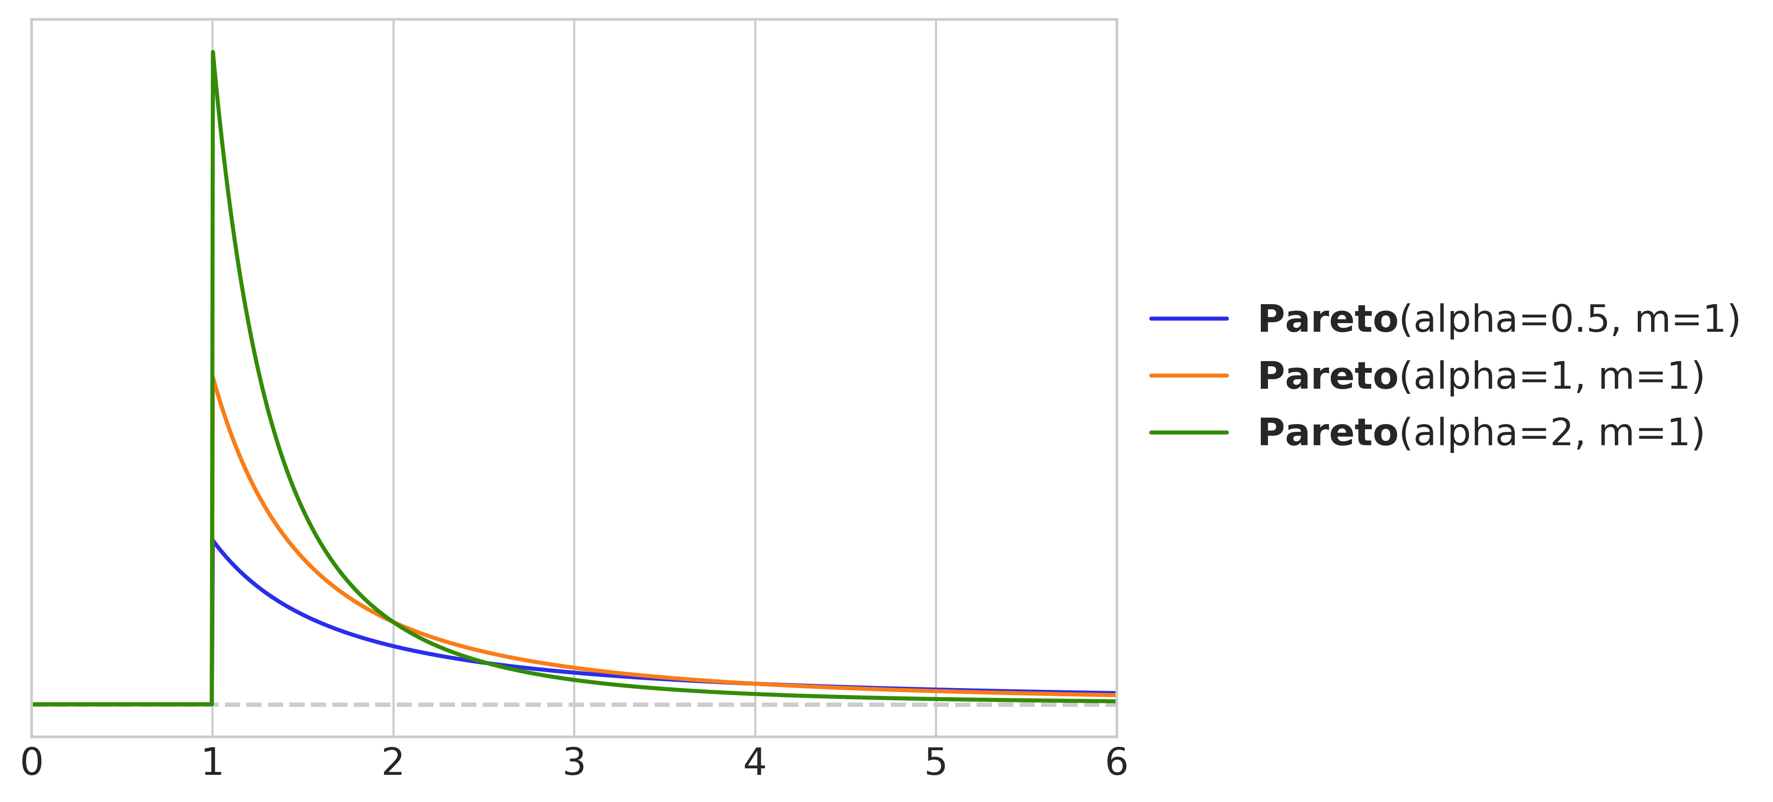
PSIS-LOO-CV
The Pareto distribution has wider tails
Wider than Student’s t distribution
We replace extreme weights (usually top 20%)
Using Pareto distribution fit to the rest of the weights
key diagnostic - shape parameter k

Slide 19
When can’t we trust LOO?
Rule of thumb:
If any K > 1 sampling variance infinite → don’t trust LOO
If more than ~5% of points have K > 0.7 → beware
Symptoms:
LOO standard error is huge
Repeated reruns give different ranking

Slide 20
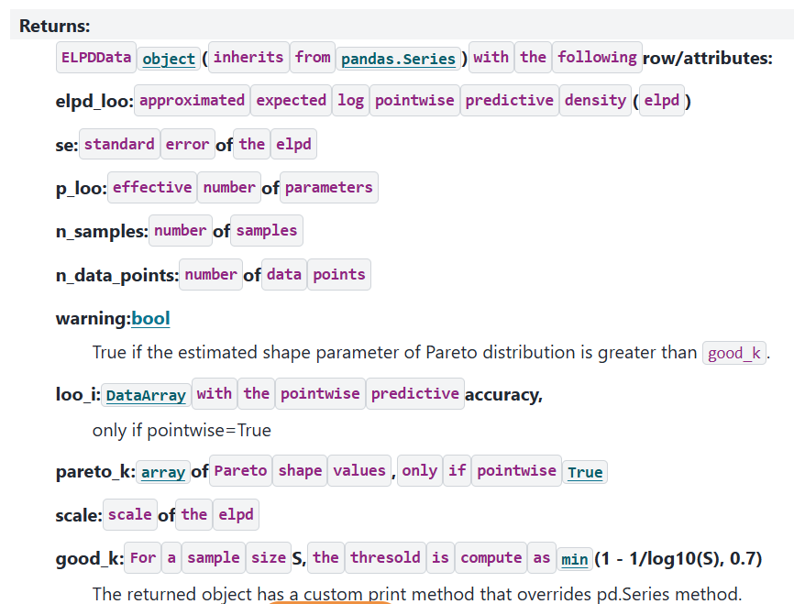
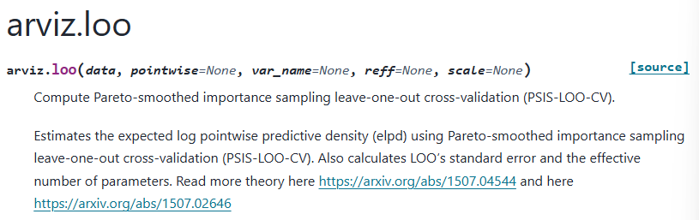
When can’t we trust LOO?
https://arxiv.org/abs/1507.04544 https://arxiv.org/abs/1507.02646

Slide 21
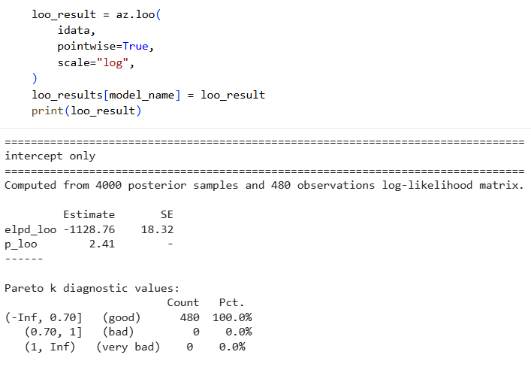
When can’t we trust LOO?
https://arxiv.org/abs/1507.04544 https://arxiv.org/abs/1507.02646

Slide 22
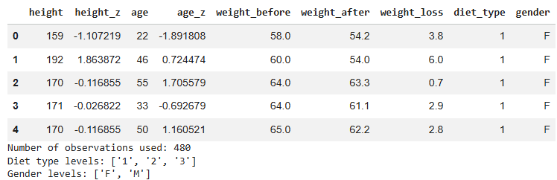
Data
Dataset - foodDiet_extended.csv
Notes:
Remainder – this is a “fake” dataset, not real data

Slide 23

Dataset and Variables
Dataset - foodDiet_extended.csv
Dependent variable
$$weight_loss_{i} ​=weight_before_{i} ​−weight_after_{i} ​$$
Predictors\ Independent variables:
Variable | Type | Transformation
age_z | continuous | standardized age
height_z | continuous | standardized height
diet_type | categorical | Coded as diet group :1, 2, 3
gender | categorical | coded as F / M
Notes:
Remainder – this is a “fake” dataset, not real data

Slide 24
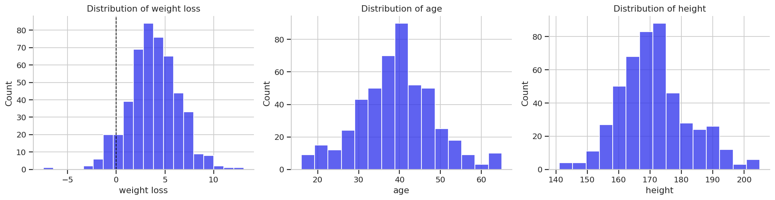

Data
Our dependent variable:
$$weight_loss_{i}=weight_{before_{i}}−weigh{t_{after}}_{i} ​$$

Slide 25
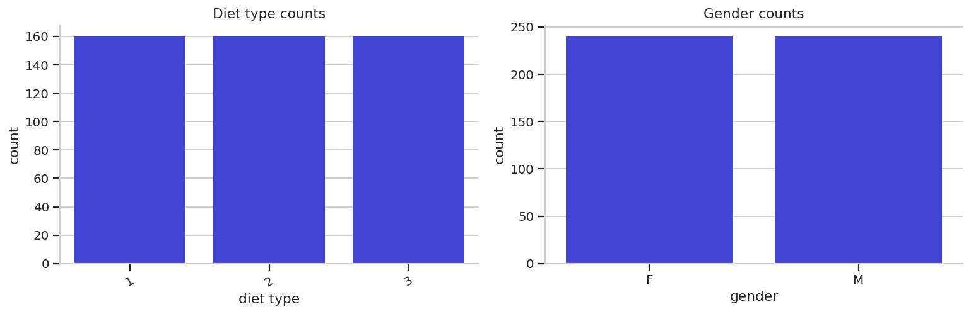
Data
Possible independent variables:

Slide 26
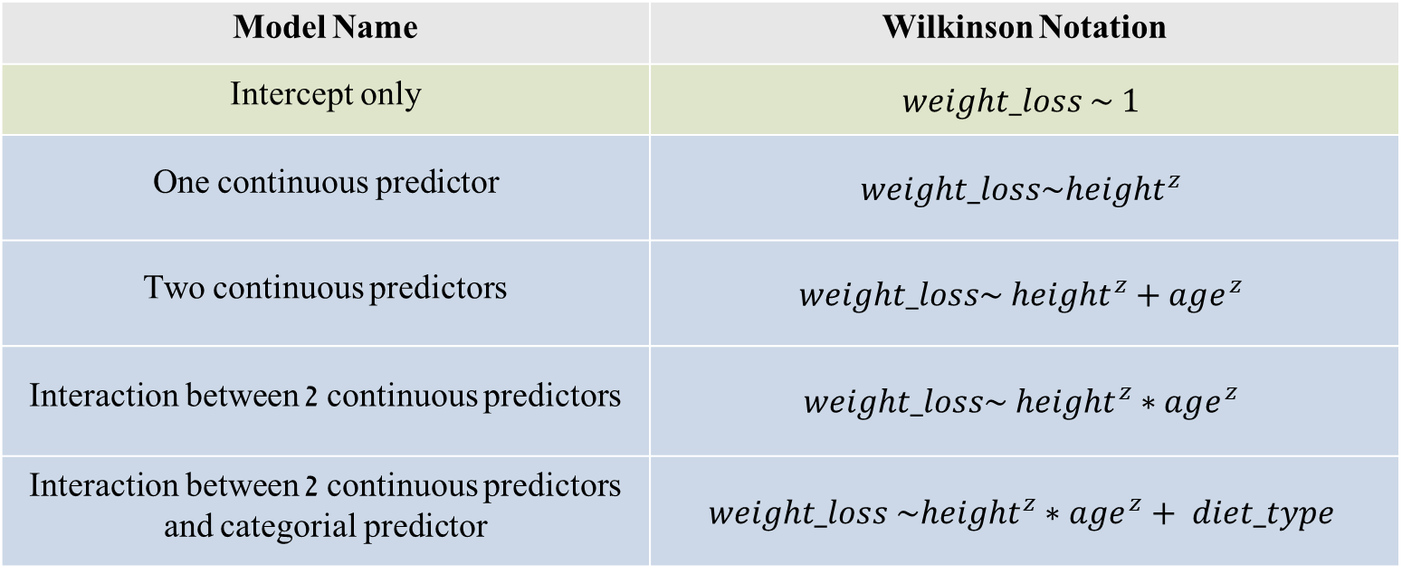
Today’s Models
Model Name | Wilkinson Notation
Intercept only | $$weight_loss \sim 1$$
One continuous predictor | $$weight_loss\sim height^{z}$$
Two continuous predictors | $$weight_loss\sim height^{z}+age^{z}$$
Interaction between 2 continuous predictors | $$weight_loss\sim height^{z}∗age^{z}$$
Interaction between 2 continuous predictors and categorial predictor | $$weight_loss \sim height^{z}∗age^{z}+ diet_type$$
Notes:
Reminder
$$weight_loss \sim diet_type ∗ gender$$
Is the same as (in Bambi and OLS)
$$weight_loss \sim diet_type + gender + diet_type:gender$$

Slide 27
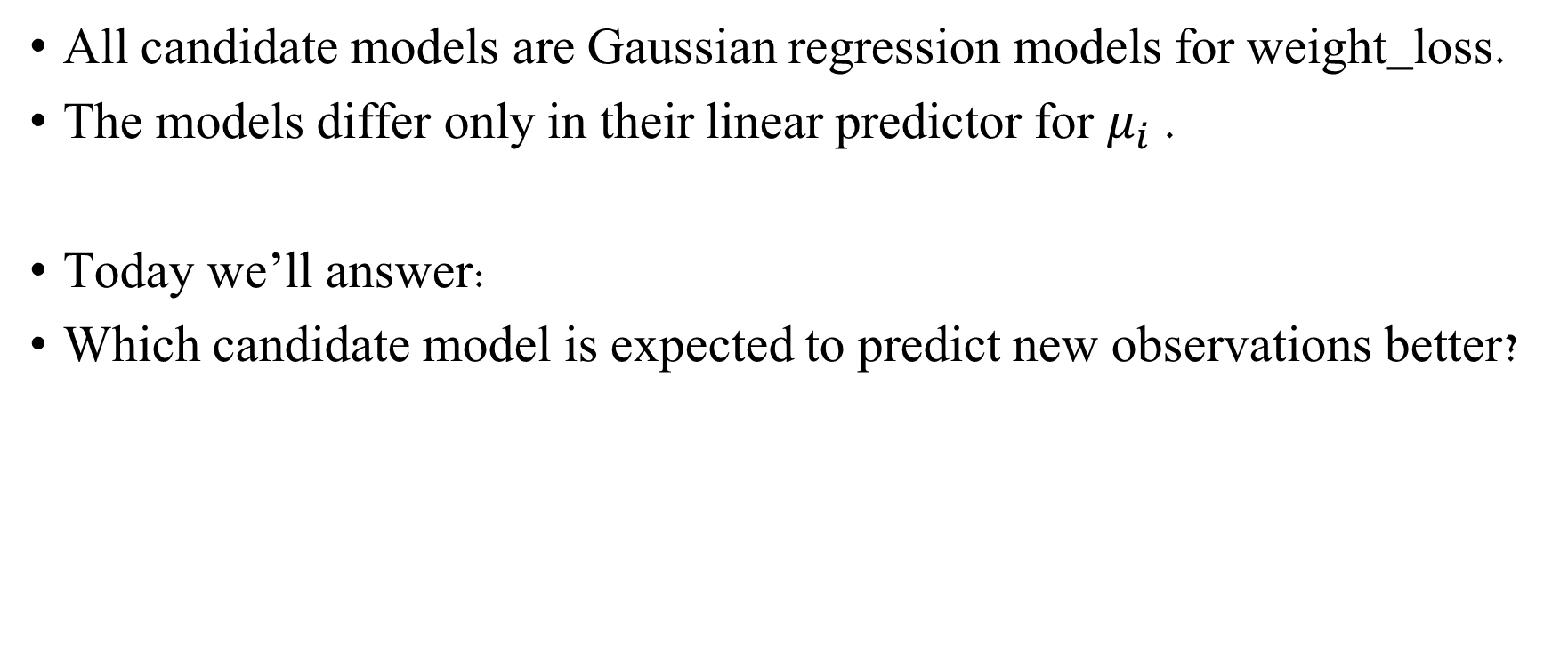
Today’s Models
All candidate models are Gaussian regression models for weight_loss.
The models differ only in their linear predictor for $μ_{i}$ .
Today we’ll answer:
Which candidate model is expected to predict new observations better?
Notes:
Reminder
$$weight_loss \sim diet_type ∗ gender$$
Is the same as (in Bambi and OLS)
$$weight_loss \sim diet_type + gender + diet_type:gender$$

Slide 28
Workflow update
1) Scientific question 2) Candidate models 3) Prior predictive check 4) Sample 5) Diagnostics 6) Posterior predictive check 7) Compare predictive accuracy 8) Interpret model differences
Diagnostics
Predictive accuracy
Data
Model
Sample
Posterior
Inference
Prior predictive sampling
Posterior predictive sampling

Slide 29
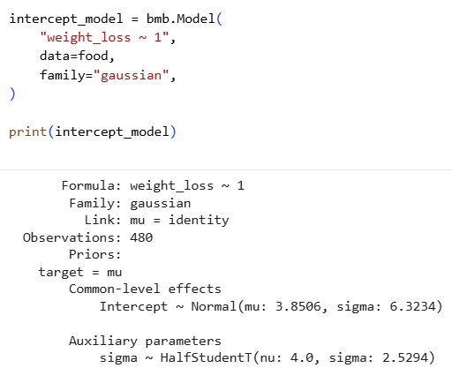
First model – Intercept only
weight_loss ~ 1
No predictors.
The model estimates one overall expected weight loss for all participants.

Slide 30
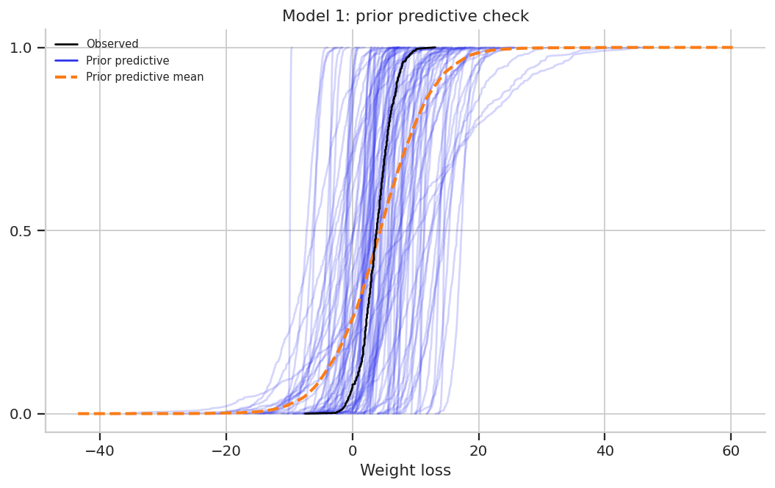
First model – Intercept only
Prior predictions

Slide 31
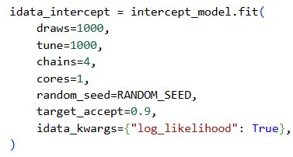
First model – Intercept only
Sampling –
idata_kwargs={"log_likelihood": True} is required for WAIC and LOO
later.
Notes:
From now on always add it to the sampling

Slide 32
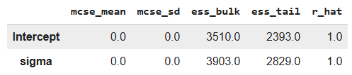
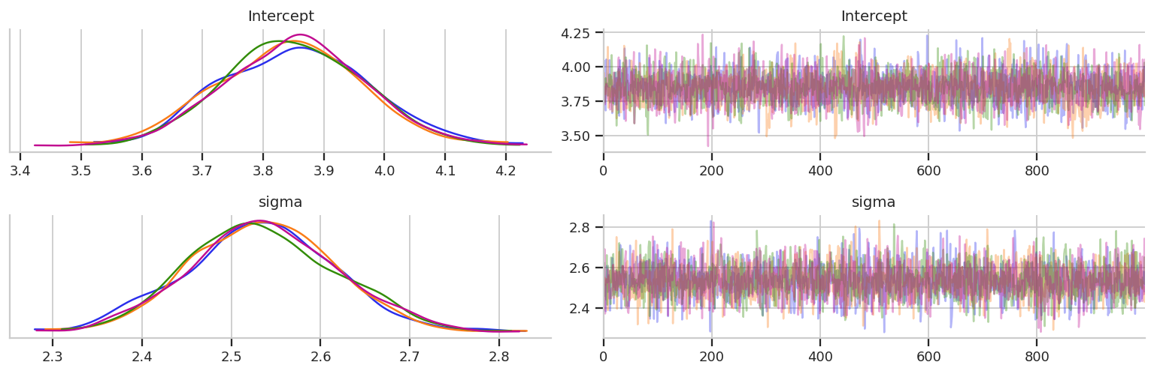
First model – Intercept only
Sampling diagnosis

Slide 33
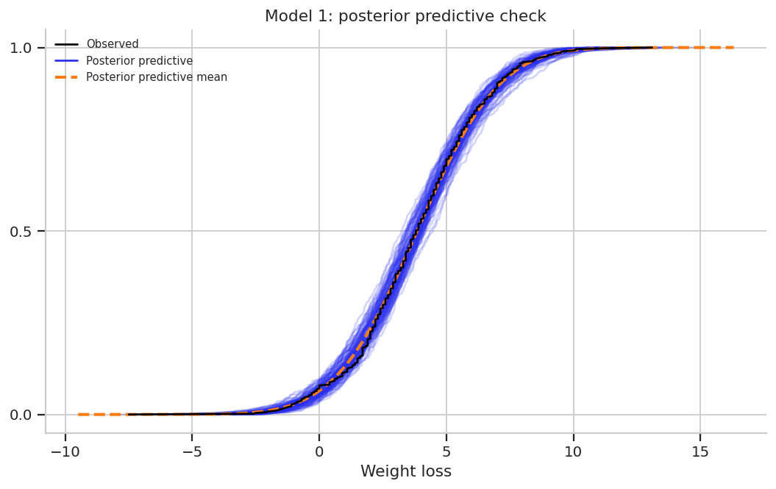
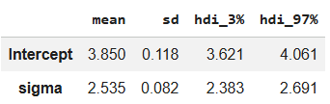
First model – Intercept only
Posterior summary & posterior predictive

Slide 34
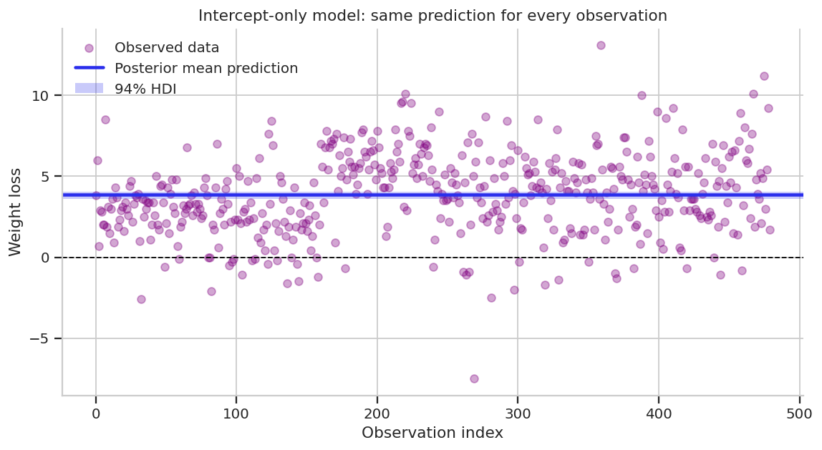
First model – Intercept only
Posterior predictive

Slide 35
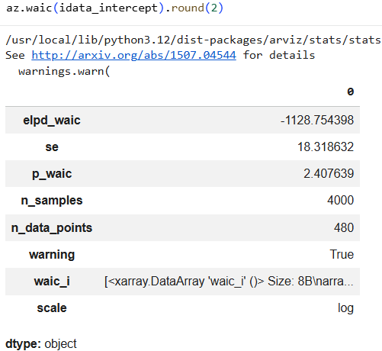
First model – Intercept only
az.waic(idata)
Expected Log Pointwise Predictive Density:
A measure of how well a model is expected to predict new (held-out) data, computed by summing the log-predictive densities for each data point.
Higher ELPD indicates higher out-of-sample predictive fit (“better” model). If scale is deviance or negative_log smaller values indicates higher out-of-sample predictive fit (“better” model).
SE - Standard error of the ELPD estimate.
Notes:
the absolute value of an ELPD score is not very meaningful on its own.
A negative value simply reflects the scale of the log-probabilities.
What matters is the relative difference: you should always interpret ELPD values in relation to other models, choosing the model with the highest (less negative) ELPD score

Slide 36
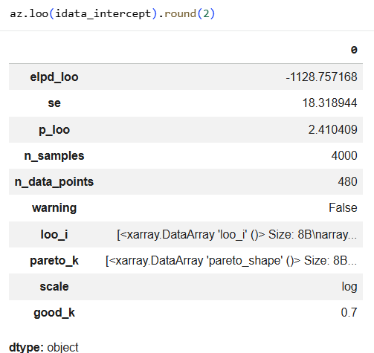
First model – Intercept only
az.loo(idata)
Effective number of parameters: penalty term that accounts for model complexity
How reliable is our estimate?
Values above 0.7 indicate that we may have very influential datapoints – bad.
We can see that 100% of our datapoints are good.
Notes:
Expected Log Pointwise Predictive Density:
A measure of how well a model is expected to predict new (held-out) data, computed by summing the log-predictive densities for each data point.
Higher ELPD indicates higher out-of-sample predictive fit (“better” model). If scale is deviance or negative_log smaller values indicates higher out-of-sample predictive fit (“better” model).
SE - Standard error of the ELPD estimate.
The term p_loo​ refers to the effective number of parameters in a model.
In the context of evaluating models using tools like Leave-One-Out (LOO) cross-validation or WAIC, p_loo​ serves as a penalty term that accounts for model complexity.
While basic information criteria might just count the exact number of variables defined in a mathematical model, this raw count is not a good reflection of true complexity in Bayesian models. Because incorporating informative priors or hierarchical structures restricts the model's flexibility-a process known as regularization-the effective number of parameters that actually influence the data fit is often smaller than the literal parameter count.
When you compute predictive accuracy using a function like az.loo or compare models with az.compare in ArviZ, ploo​ is reported alongside the Expected Log Pointwise Predictive Density (ELPD) to help you understand the complexity penalty being applied to your model's predictive accuracy

Slide 37
First model – Intercept only
az.loo(idata)
How reliable is our estimate?
Values above 0.7 indicate that we may have very influential datapoints – bad.
We can see that 100% of our datapoints are good.
Notes:
Expected Log Pointwise Predictive Density:
A measure of how well a model is expected to predict new (held-out) data, computed by summing the log-predictive densities for each data point.
Higher ELPD indicates higher out-of-sample predictive fit (“better” model). If scale is deviance or negative_log smaller values indicates higher out-of-sample predictive fit (“better” model).
SE - Standard error of the ELPD estimate.
The term p_loo​ refers to the effective number of parameters in a model.
In the context of evaluating models using tools like Leave-One-Out (LOO) cross-validation or WAIC, p_loo​ serves as a penalty term that accounts for model complexity.
While basic information criteria might just count the exact number of variables defined in a mathematical model, this raw count is not a good reflection of true complexity in Bayesian models. Because incorporating informative priors or hierarchical structures restricts the model's flexibility-a process known as regularization-the effective number of parameters that actually influence the data fit is often smaller than the literal parameter count.
When you compute predictive accuracy using a function like az.loo or compare models with az.compare in ArviZ, ploo​ is reported alongside the Expected Log Pointwise Predictive Density (ELPD) to help you understand the complexity penalty being applied to your model's predictive accuracy

Slide 38
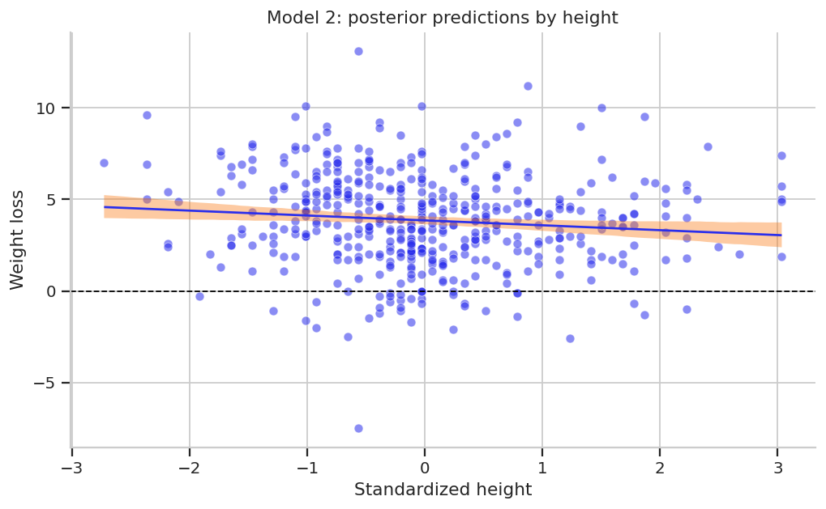
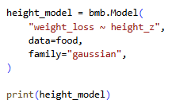
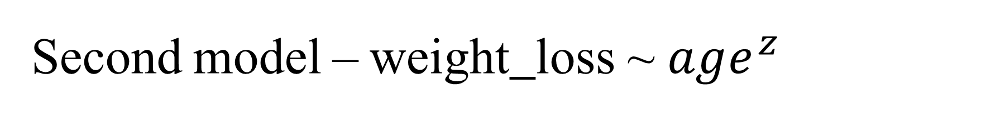
Second model – weight_loss ~ $age^{z}$
Does height improve prediction relative to the intercept-only model?

Slide 39
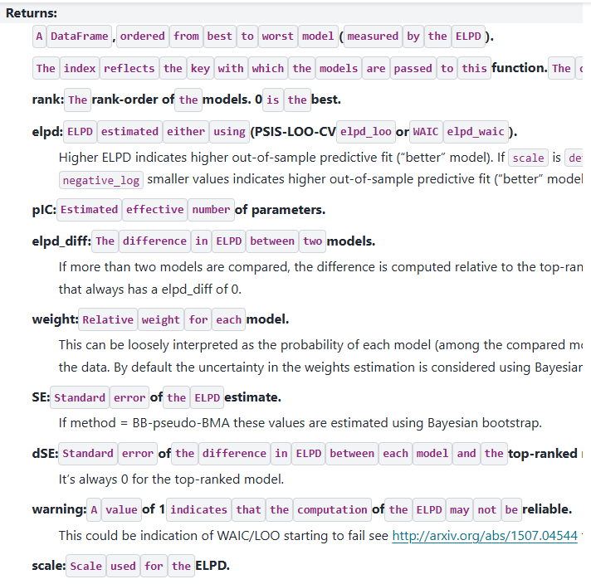
az. compare
https://python.arviz.org/en/stable/api/generated/arviz.compare.html
Rank – The rank-order of the models. 0 is the best.
ELPD Diff – The difference in ELPD between two models. If more than two models are compared, the difference is computed relative to the top-ranked model, that always has a elpd_diff of 0.
dSE – Standard error of the difference in ELPD between each model and the top-ranked model. It’s always 0 for the top-ranked model.
Notes:
Rank – The rank-order of the models. 0 is the best.
ELPD - Higher ELPD indicates higher out-of-sample predictive fit (“better” model). If scale is deviance or negative_log smaller values indicates higher out-of-sample predictive fit (“better” model).
ELPD Diff – The difference in ELPD between two models. If more than two models are compared, the difference is computed relative to the top-ranked model, that always has a elpd_diff of 0.
SE - Standard error of the ELPD estimate. If method = BB-pseudo-BMA these values are estimated using Bayesian bootstrap.
dSE – Standard error of the difference in ELPD between each model and the top-ranked model. It’s always 0 for the top-ranked model.
*elpd stands for Expected Log Pointwise Predictive Density. It is a measure of how well a model is expected to predict new (held-out) data, computed by summing the log-predictive densities for each data point.

Slide 40
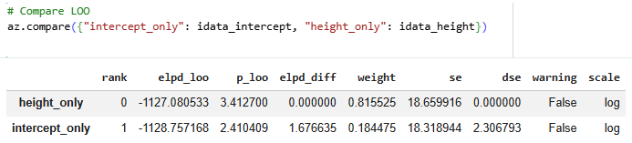
az,.compare – first & second model
Does diet type improve prediction?
From best to worst
If the difference between the elpd values is bigger
than the standard error
Then we say that there is a meaningful difference between the two models

Slide 41

az.compare – first & second model
we can do the same with the widely accepted information criteria.
The WAIC and LOO values are generally almost exactly the same.
At this point, it is generally more accepted to use the LOO.
From best to worst
Can’t trust WAIC

Slide 42
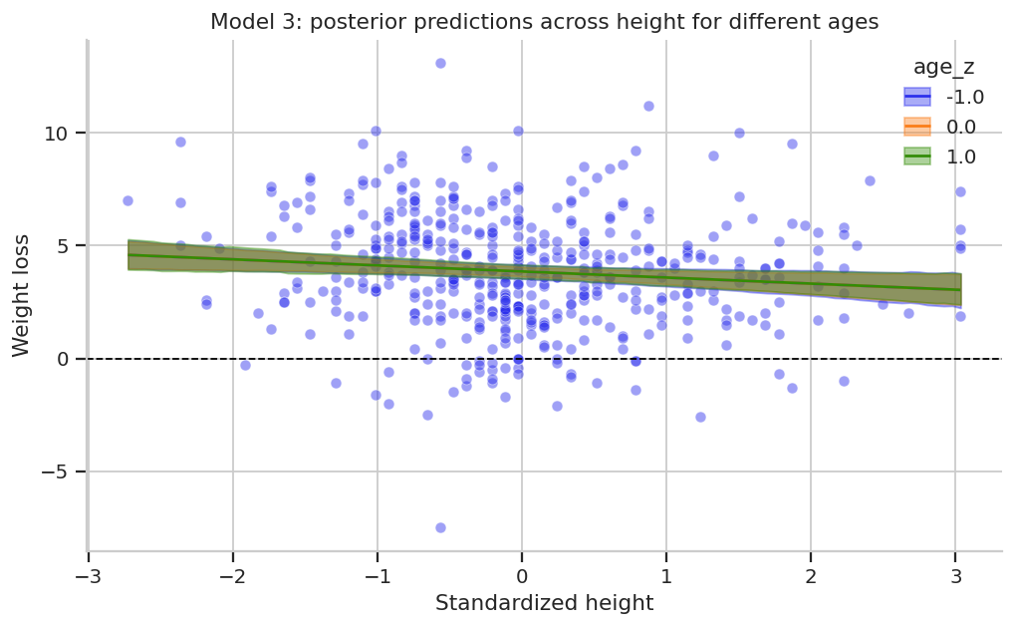
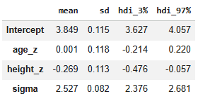

Let’s see more candidates’ models
Model 3: $weight_loss \sim height^{z}+ age^{z}$

Slide 43
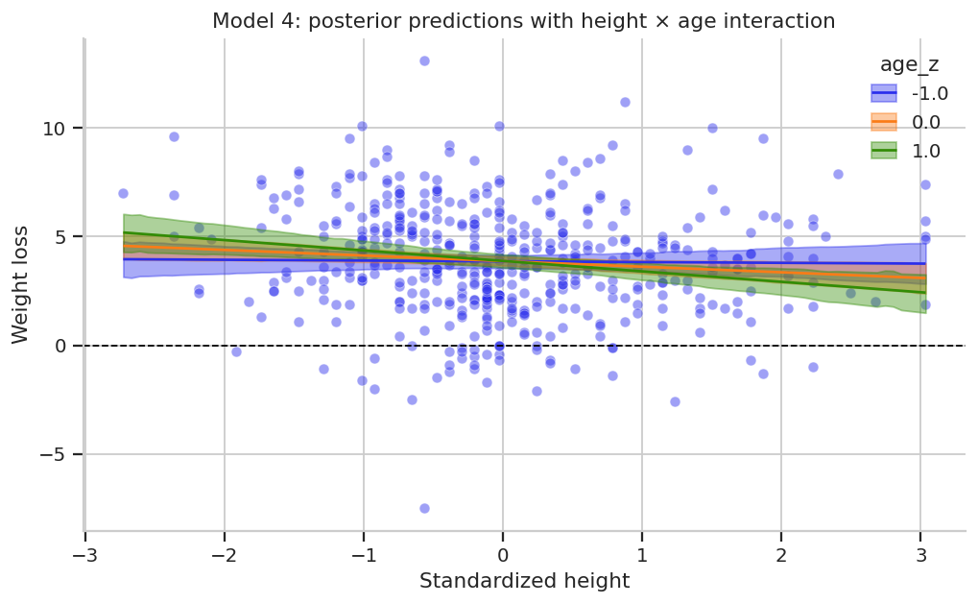
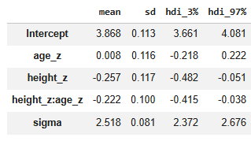

Let’s see more of the candidates models
Model 4:$weight_loss\sim height^{z}∗age^{z}$

Slide 44
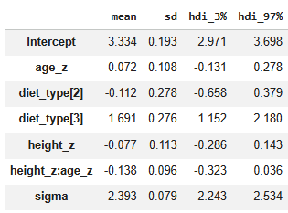

Let’s see more of the candidates models
Model 5:$weight_loss\sim height^{z}∗age^{z}+diet_type$

Slide 45
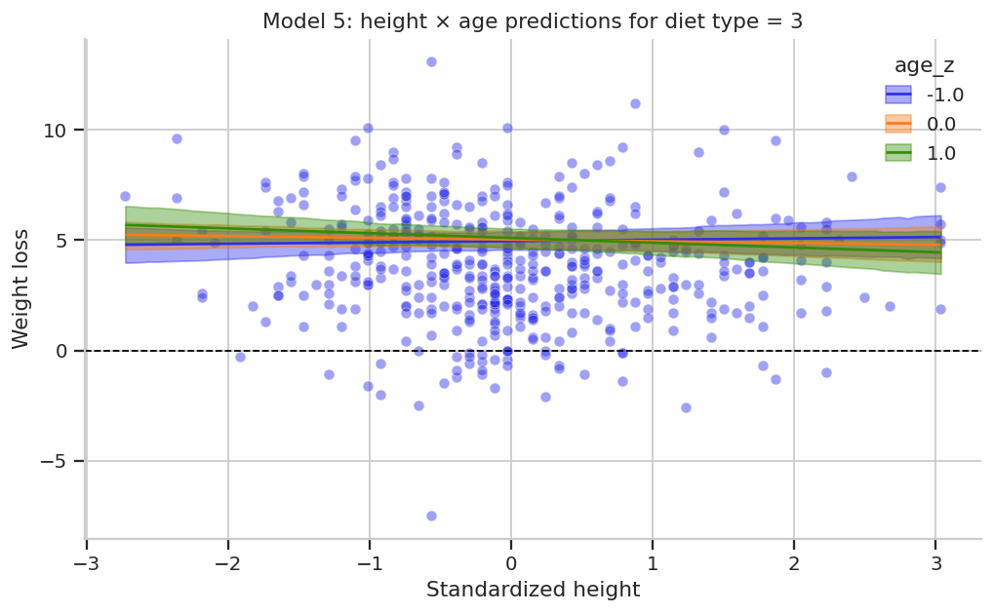
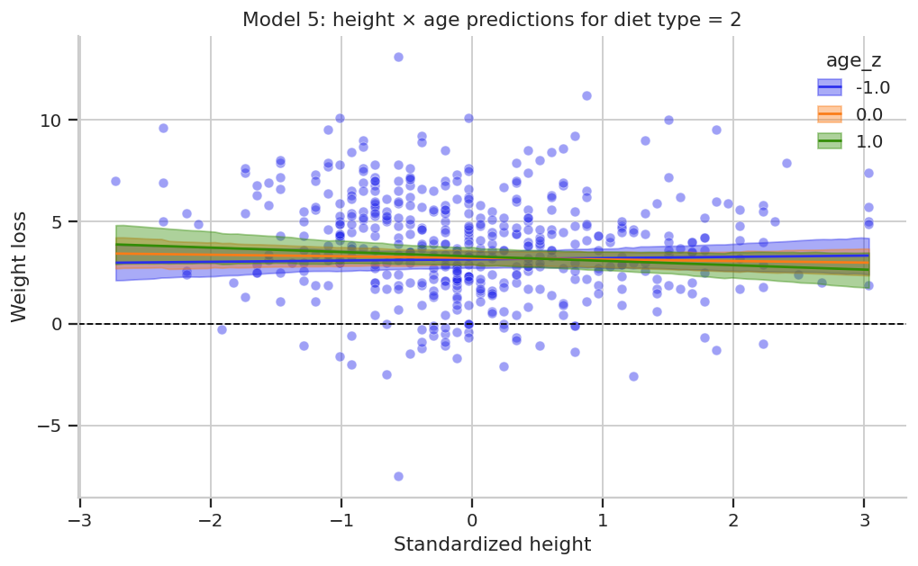
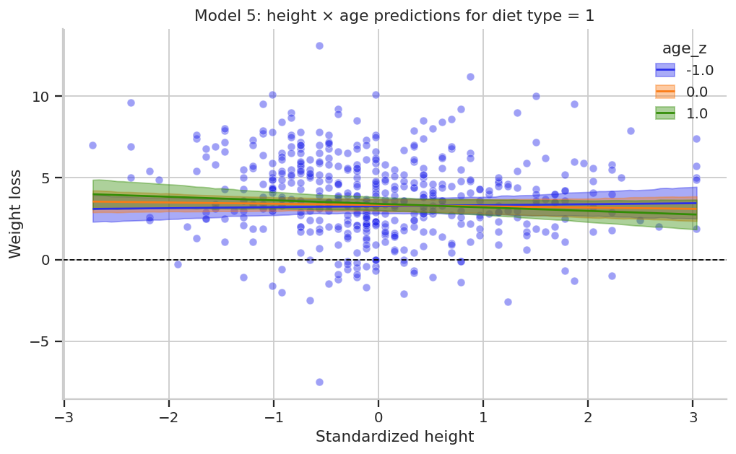

Let’s see more of the candidates models
Model 5: $weight_loss\sim height^{z}∗age^{z}+diet_type$
diet_type=3 diet_type=2 diet_type=1

Slide 46
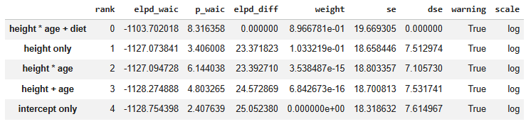
Model comparison
WAIC
Notes:
The standard error of all the differences is on the scale of the differences themselves

Slide 47
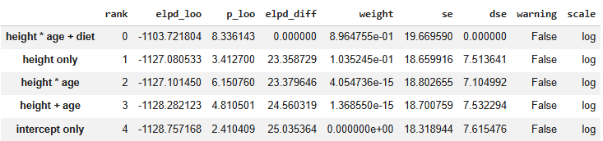
Model comparison
LOO
Notes:
The standard error of all the differences is on the scale of the differences themselves

Slide 48
Reminder: Effect size and prediction answer different questions
Tools | Good model means | Goal
posterior contrasts, effect sizes | Interpretable and meaningful | Theory building
ROPE/HDI, Bayes factor | Rules out a simple model | Hypothesis testing
AIC, WAIC, LOO | Predicts new data well | Prediction

Slide 49
Effect size and prediction answer different questions
Quantity | Question
R² | How much variance does the model explain?
partial R², η² | What does one term add?
Cohen's f | Effect size in residual-variance units
AIC / WAIC / LOO | Which model predicts new data better?

Slide 50

Effect sizes for the models

Slide 51

Effect sizes for the terms

Slide 52
Workflow update
1) Scientific question 2) Candidate models 3) Prior predictive check 4) Sample 5) Diagnostics 6) Posterior predictive check 7) Compare predictive accuracy 8) Interpret model differences
Watch for
• Compare models that answer the scientific question • Never compare models before checking diagnostics • Predictive ranking usually doesn’t replace interpretation

